Slide 1
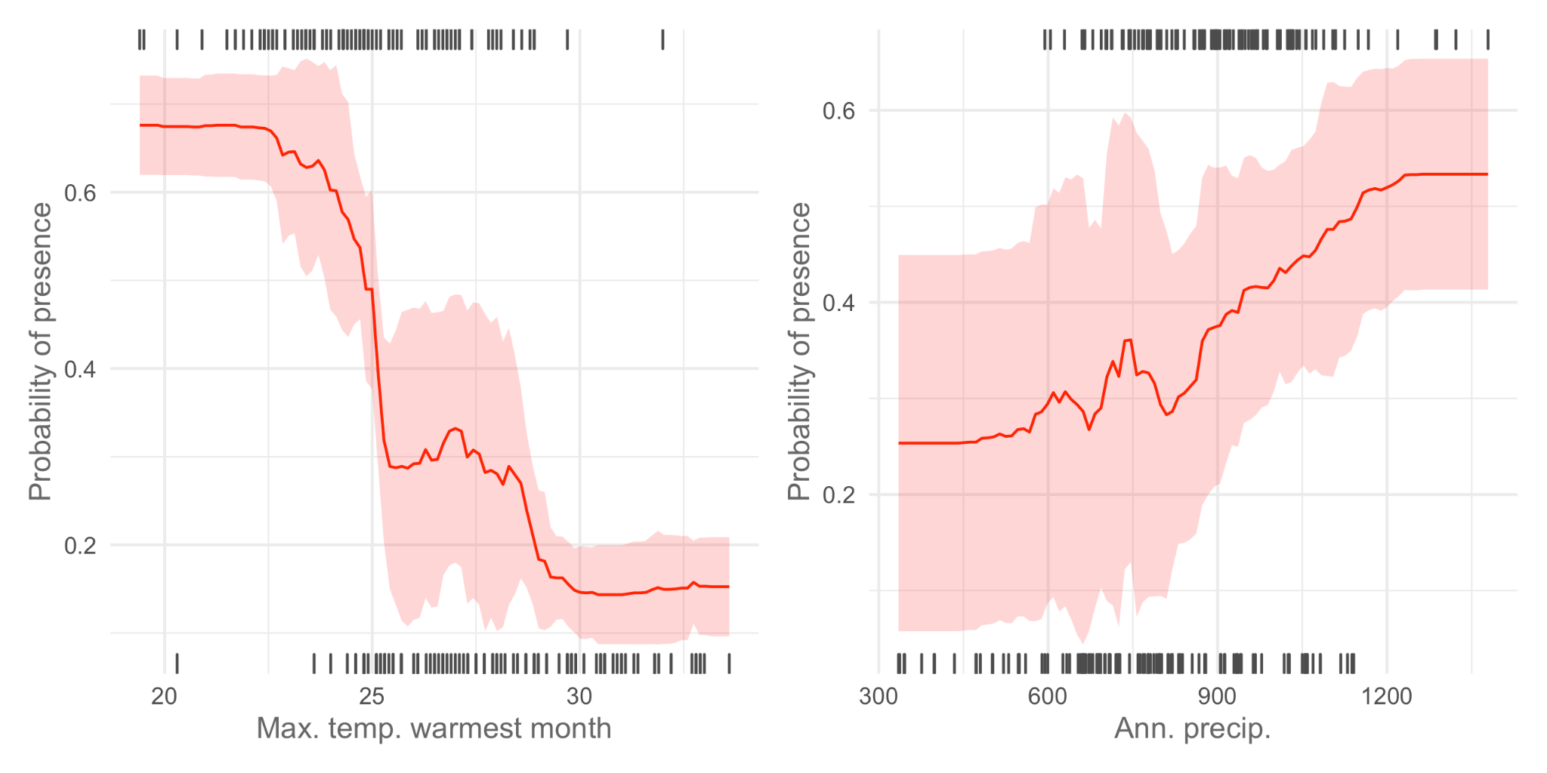
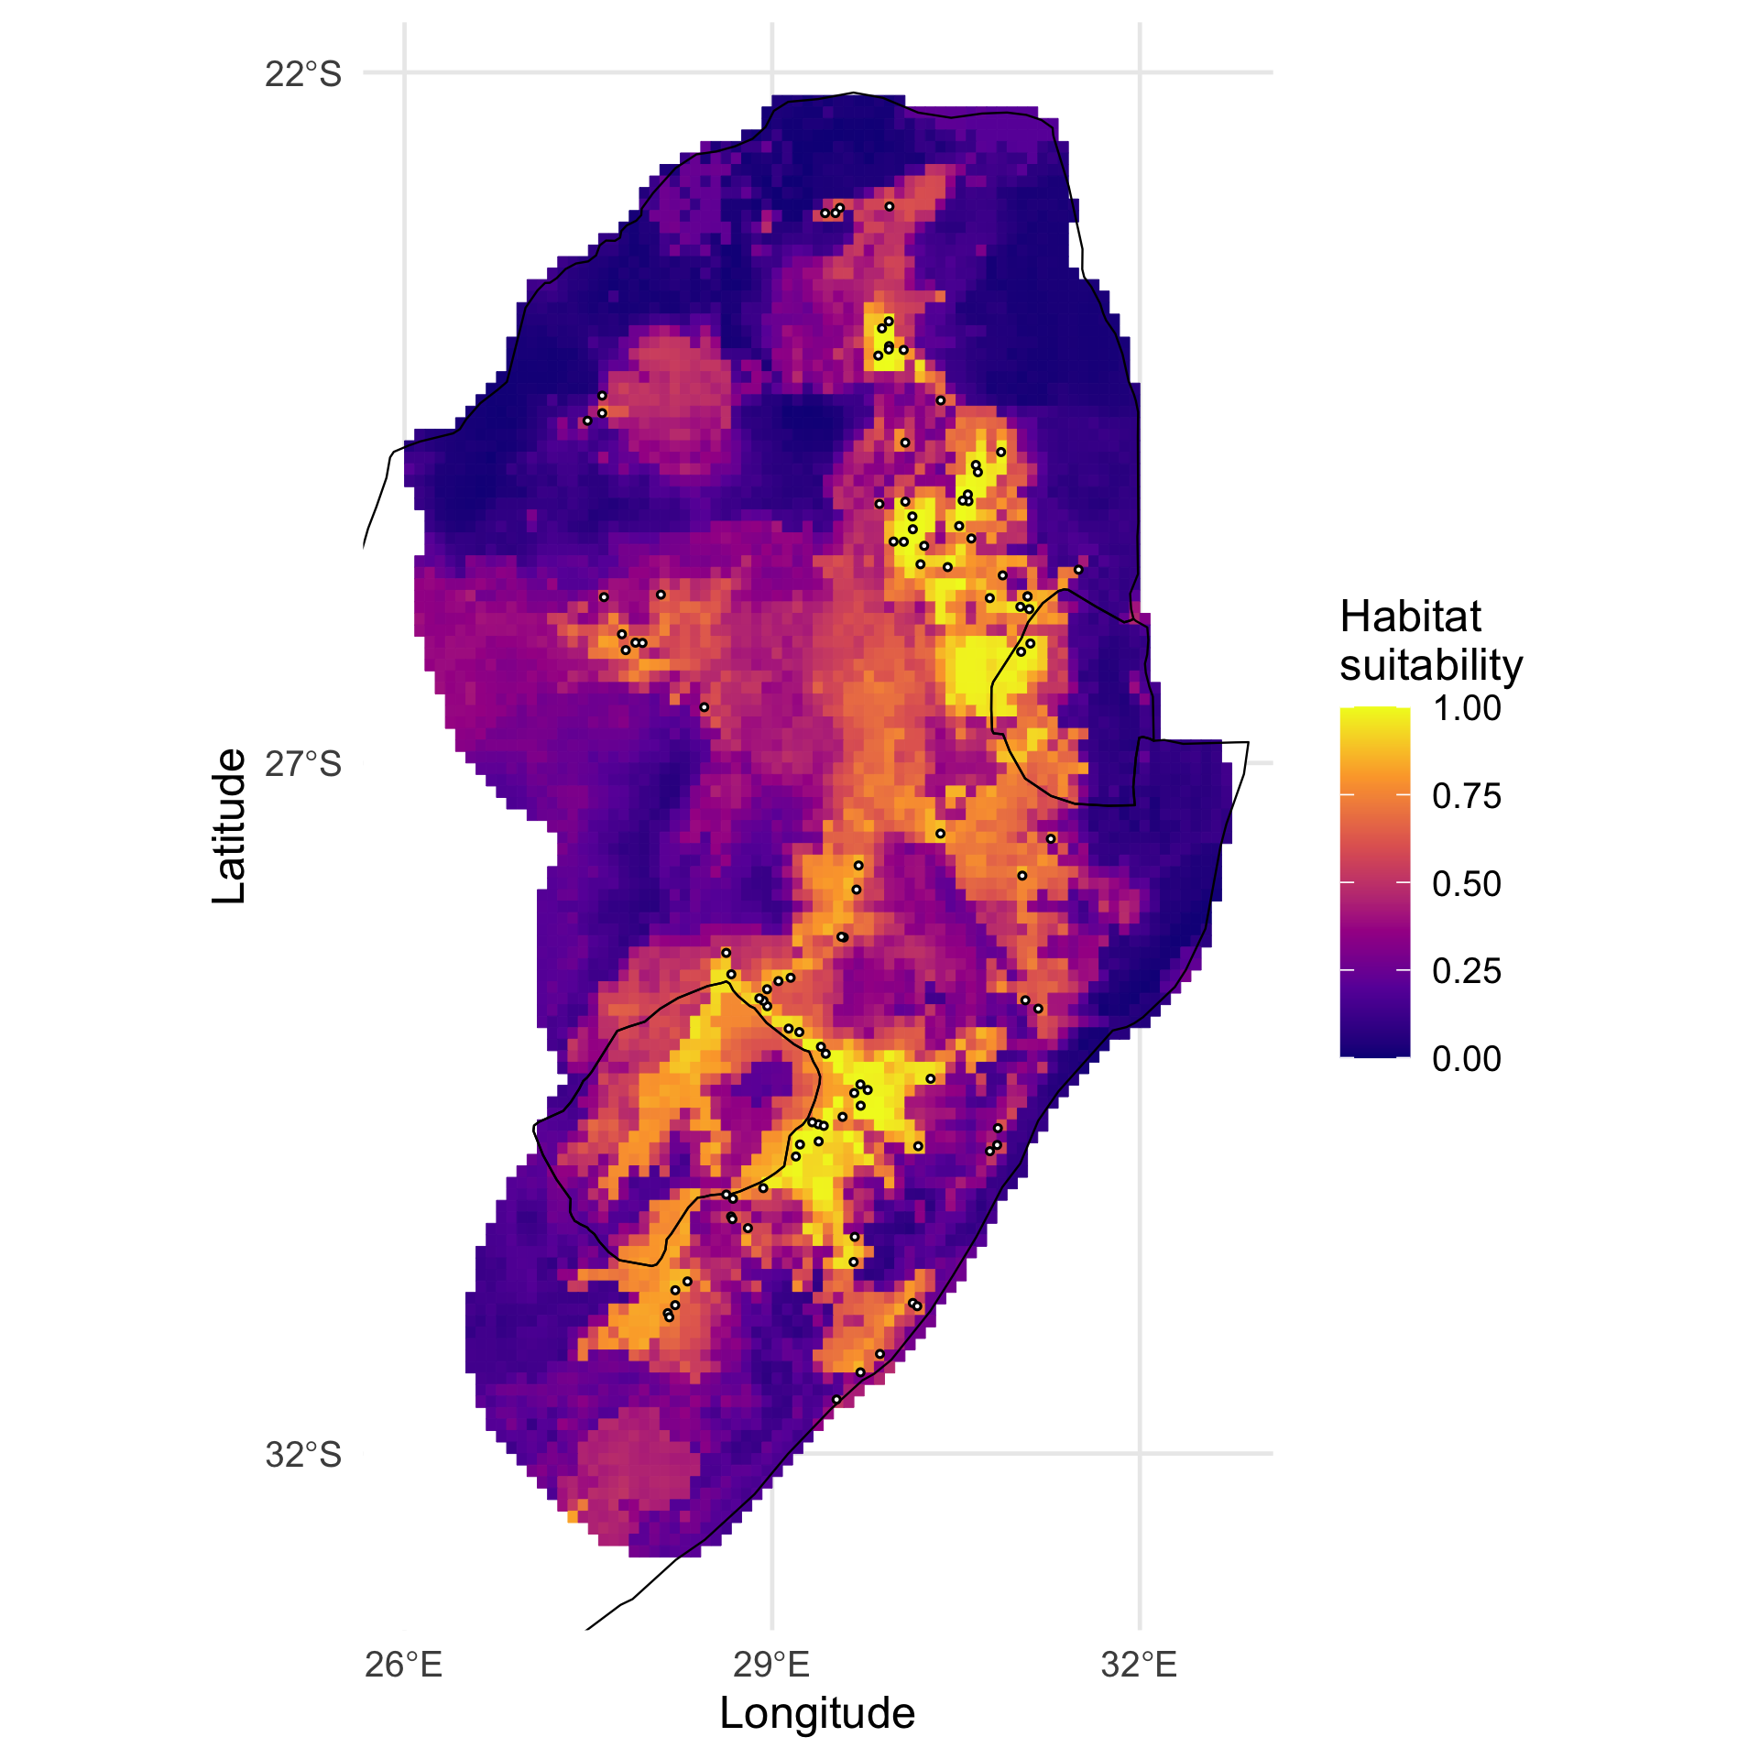
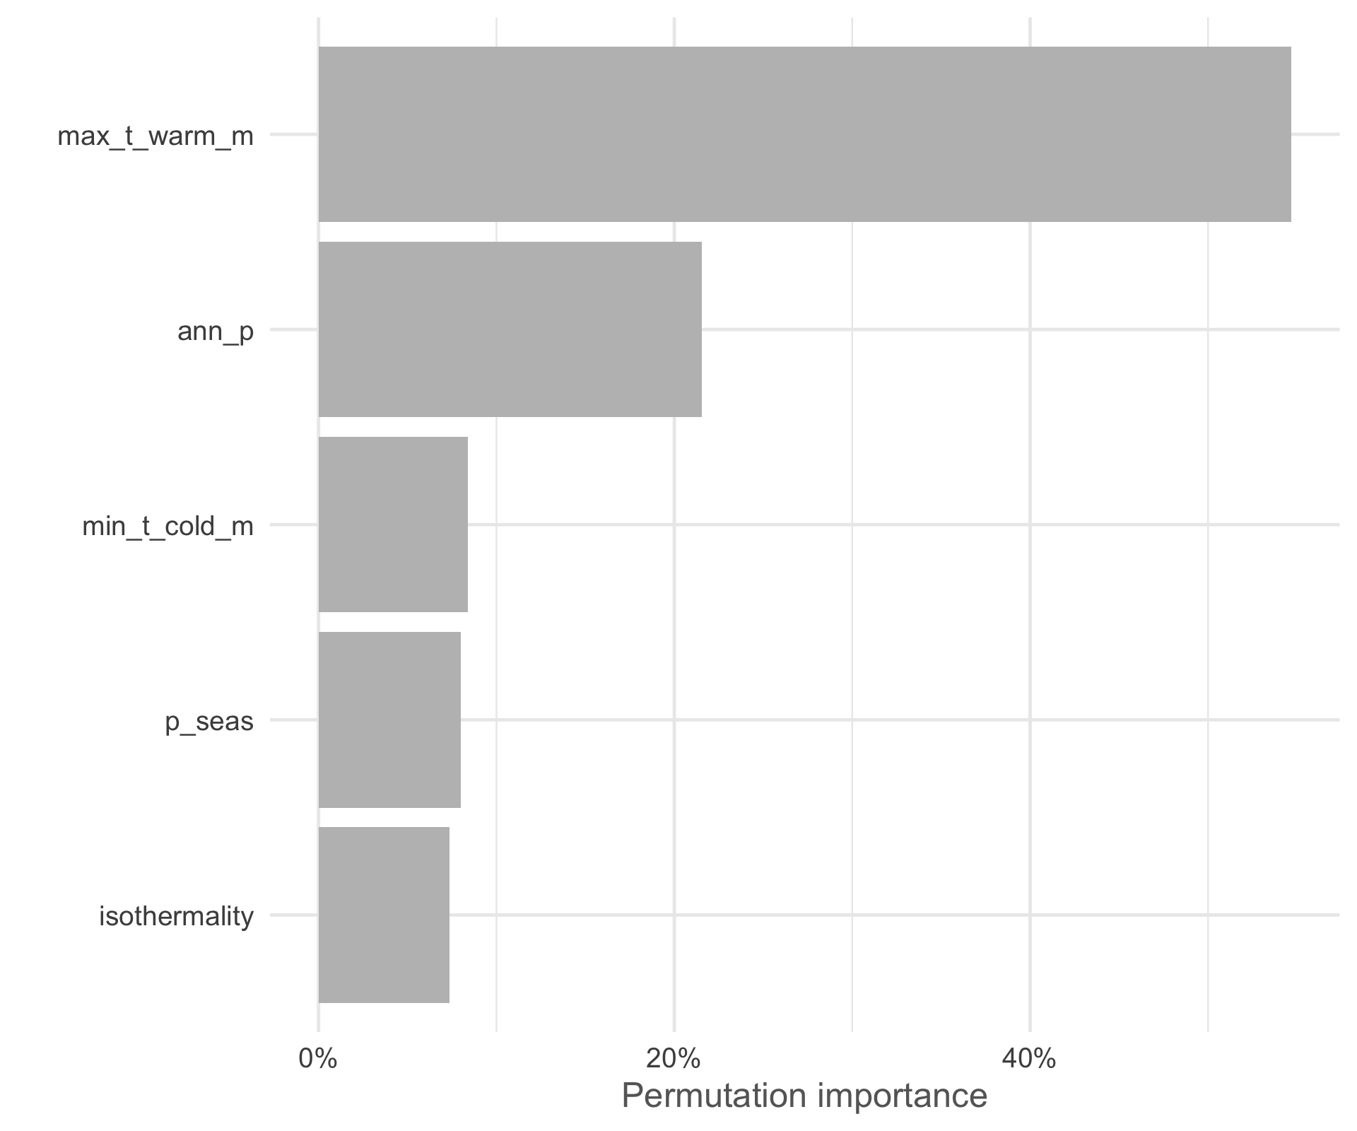
MSc Spatial Analysis Course Day 4
Joseph White, Tarciso Leao,
Felix Lim, Carolina Tovar
November 2023

Slide 2
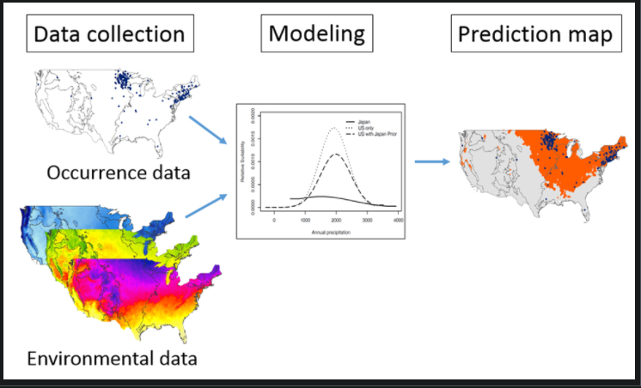
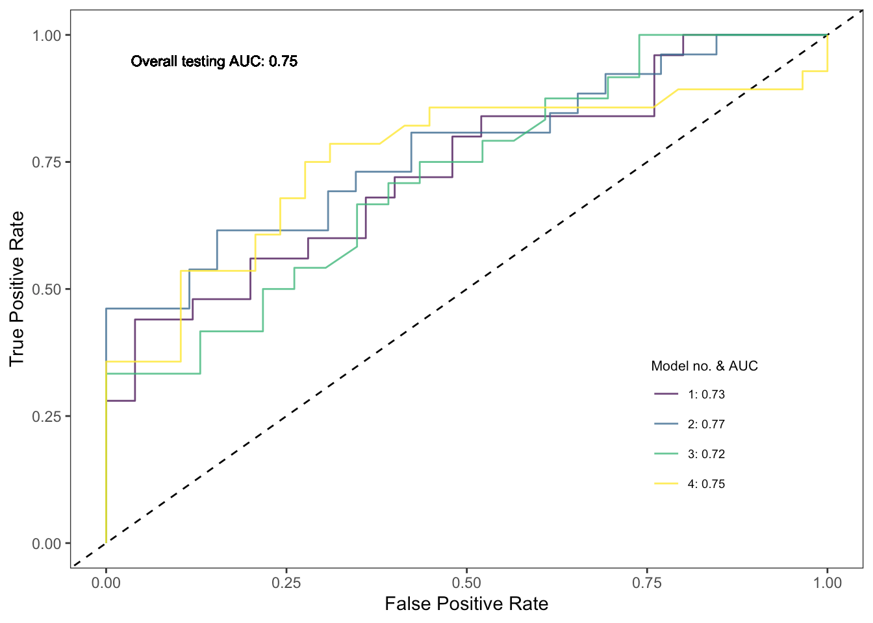
Species Distribution Models
SPATIAL ANALYSIS
Model evaluation

Slide 3
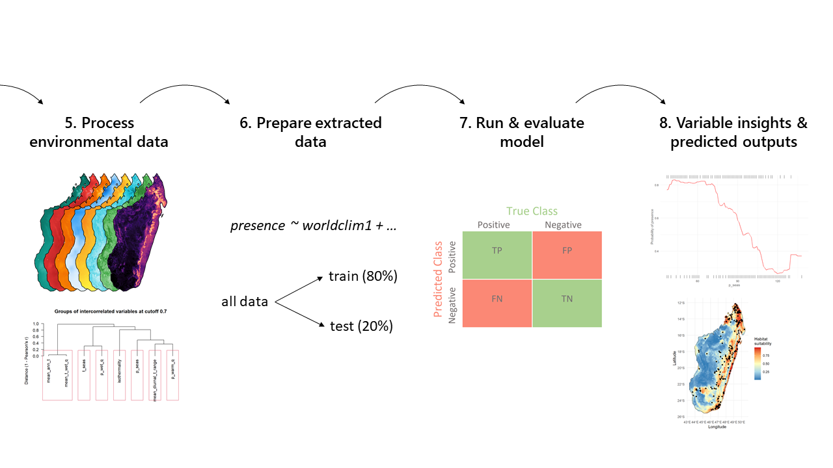
SPATIAL ANALYSIS
Day 3: Species Distribution Modeling

Slide 4
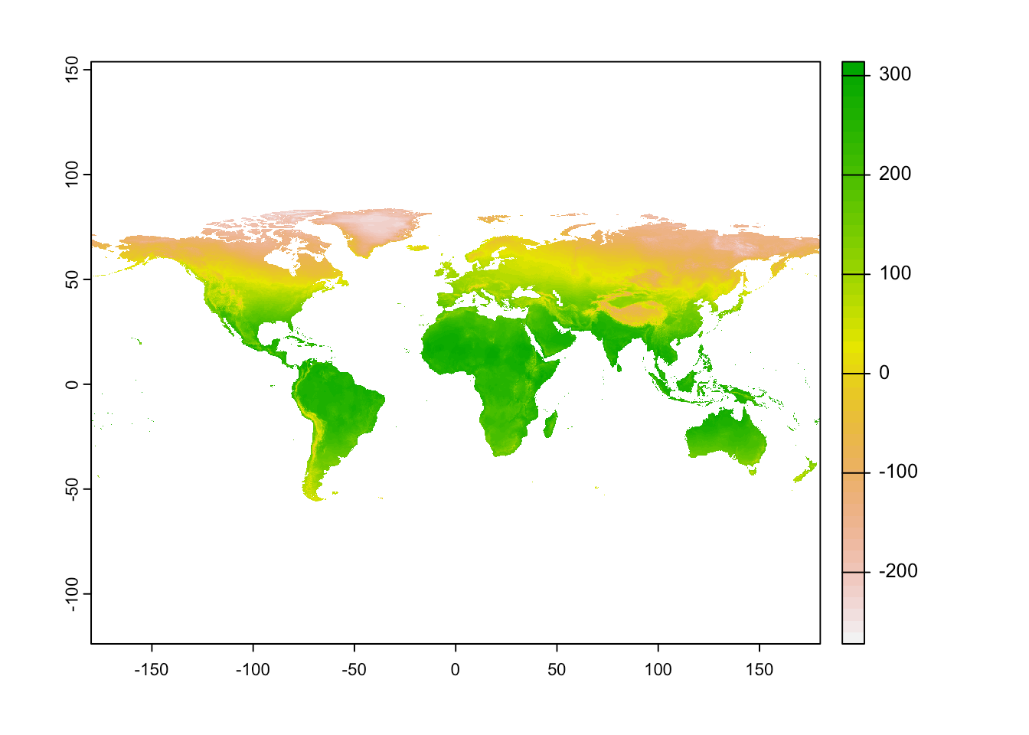
SPATIAL ANALYSIS
Environmental Data
Huge range of options
Climatic/topographic/edaphic
Biological/interactions
Worldclim bioclimatic variables are commonly used

Slide 5
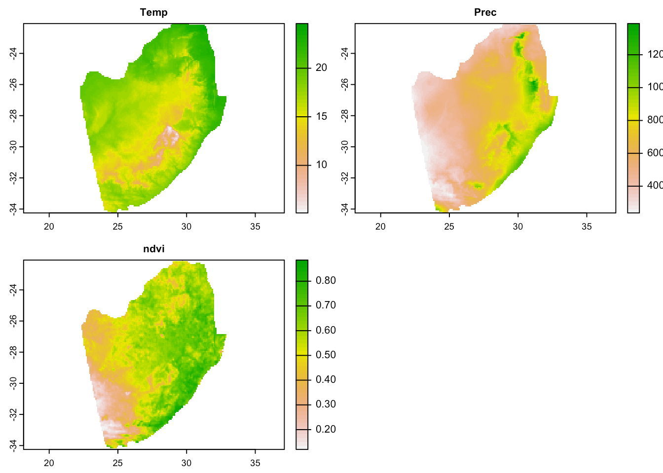
SPATIAL ANALYSIS
Environmental Data
Note 1: it is very important to
choose a relevant
Area Of Interest (AOI)
Note 2: it is very important to choose relevant variables.
The models will not tell you whether there is a mechanistic link to the occurrence & env. data.
That is up to your understanding & consideration as a scientist.

Slide 6
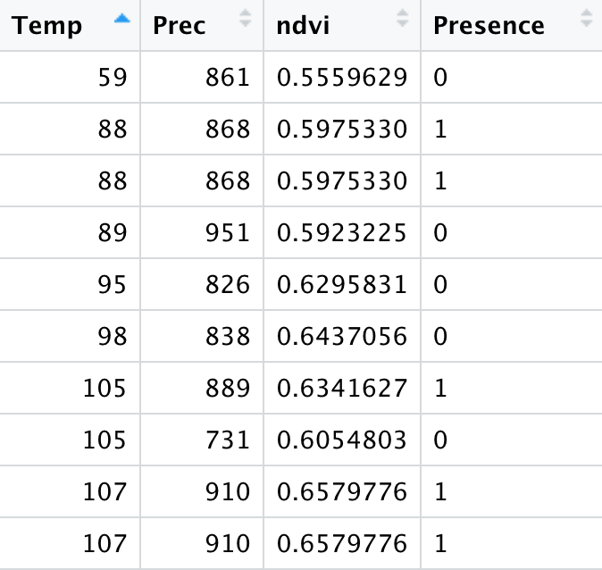
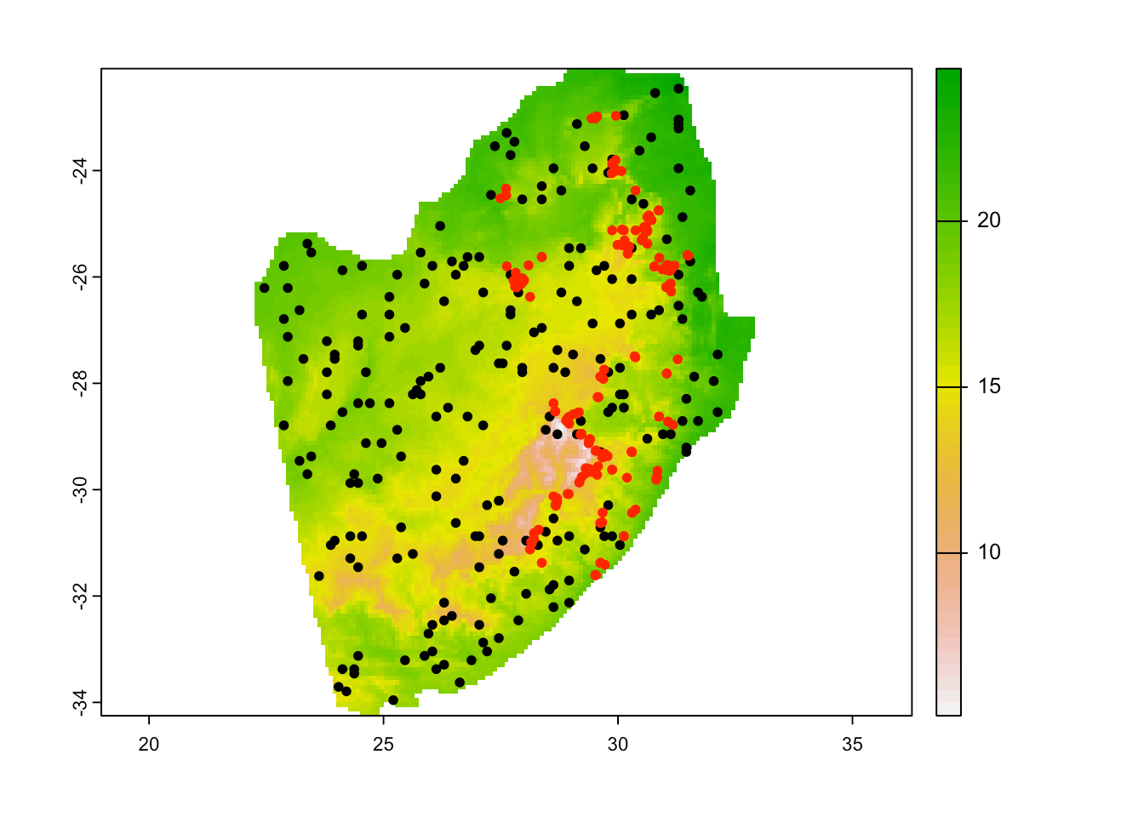
SPATIAL ANALYSIS
SMD dataset: extract env. data for occurrence data

Slide 7
Machine learning modeling
SPATIAL ANALYSIS
Training data
n = 312
Used by the model to discover & learn
70%
Full dataset
n = 448
30%
Testing data
n = 136
“Unseen” data. Used to evaluate the model performance

Slide 8
What’s happening in the background
of a Random Forest model?
SPATIAL ANALYSIS

Slide 9
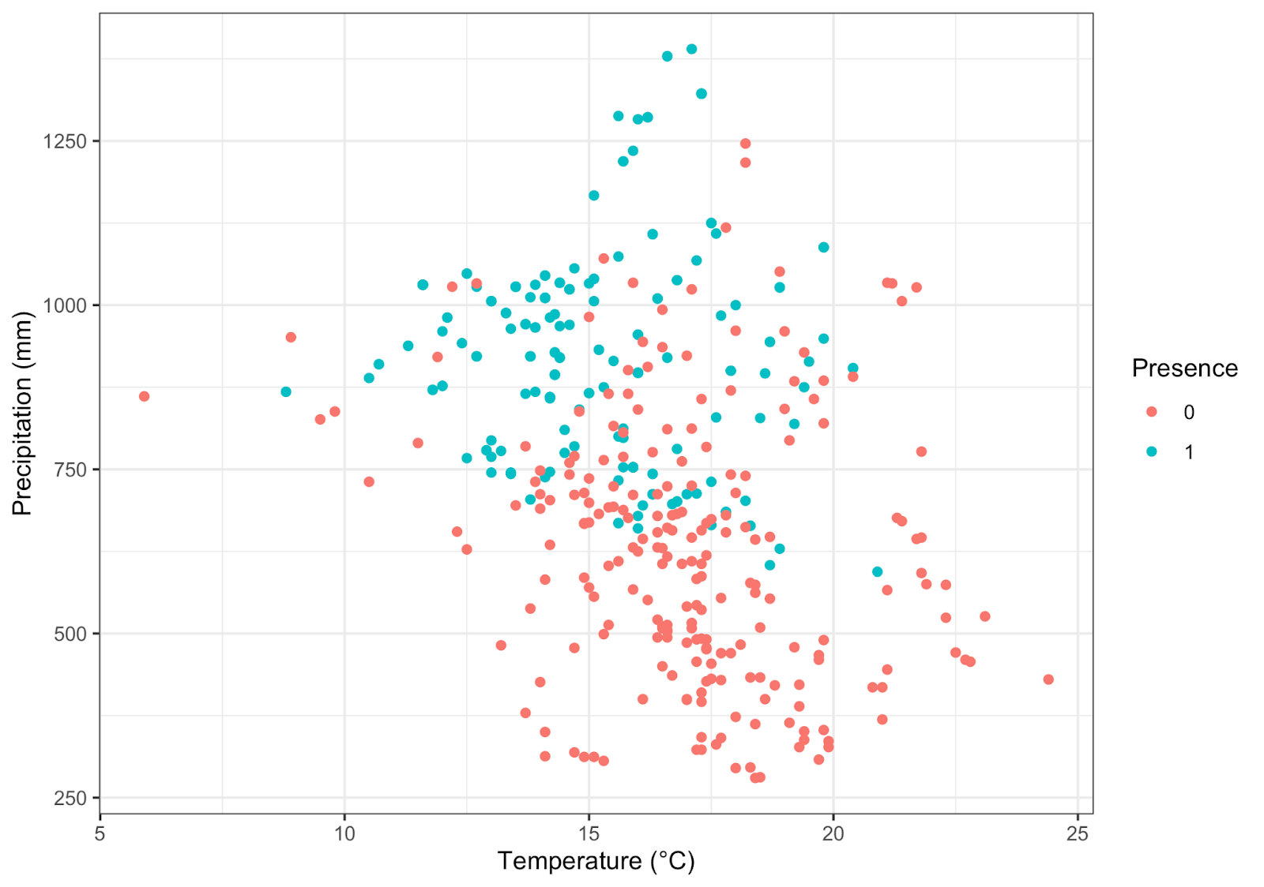
Decision Tree: training data
SPATIAL ANALYSIS

Slide 10
Decision Tree: training data
SPATIAL ANALYSIS
Prec > 900 mm

Slide 11
Decision Tree: training data
SPATIAL ANALYSIS
Prec > 900 mm
true
false
Present

Slide 12
Decision Tree: training data
SPATIAL ANALYSIS
Prec > 900 mm
true
false
Present

Slide 13
Decision Tree: training data
SPATIAL ANALYSIS
Prec > 900 mm
true
false

Slide 14
Decision Tree: training data
SPATIAL ANALYSIS
Prec > 900 mm
true
false
Present
Temp > 15°C
true
false
Background

Slide 15
Decision Tree: training data
SPATIAL ANALYSIS
Prec > 900 mm
true
false
Present
Temp > 15°C
true
false
Background
Prec > 750 mm
true
false
Present
Background

Slide 16
Random Forest = aggregation of decision trees
SPATIAL ANALYSIS
Prec > 900 mm
ndvi > 0.6
tree_{n……}
tree₁₀₀
true
true
false
false
Classification (1/0) =
Majority rule
(i.e. threshold >0.5)
Present
Temp > 15°C
Present
Temp > 16°C
true
false
true
false
Probability (%)
=
Proportion of votes
Background
Prec > 750 mm
Background
Prec > 800 mm
true
false
true
false
Present
Background
Present
Background

Slide 17
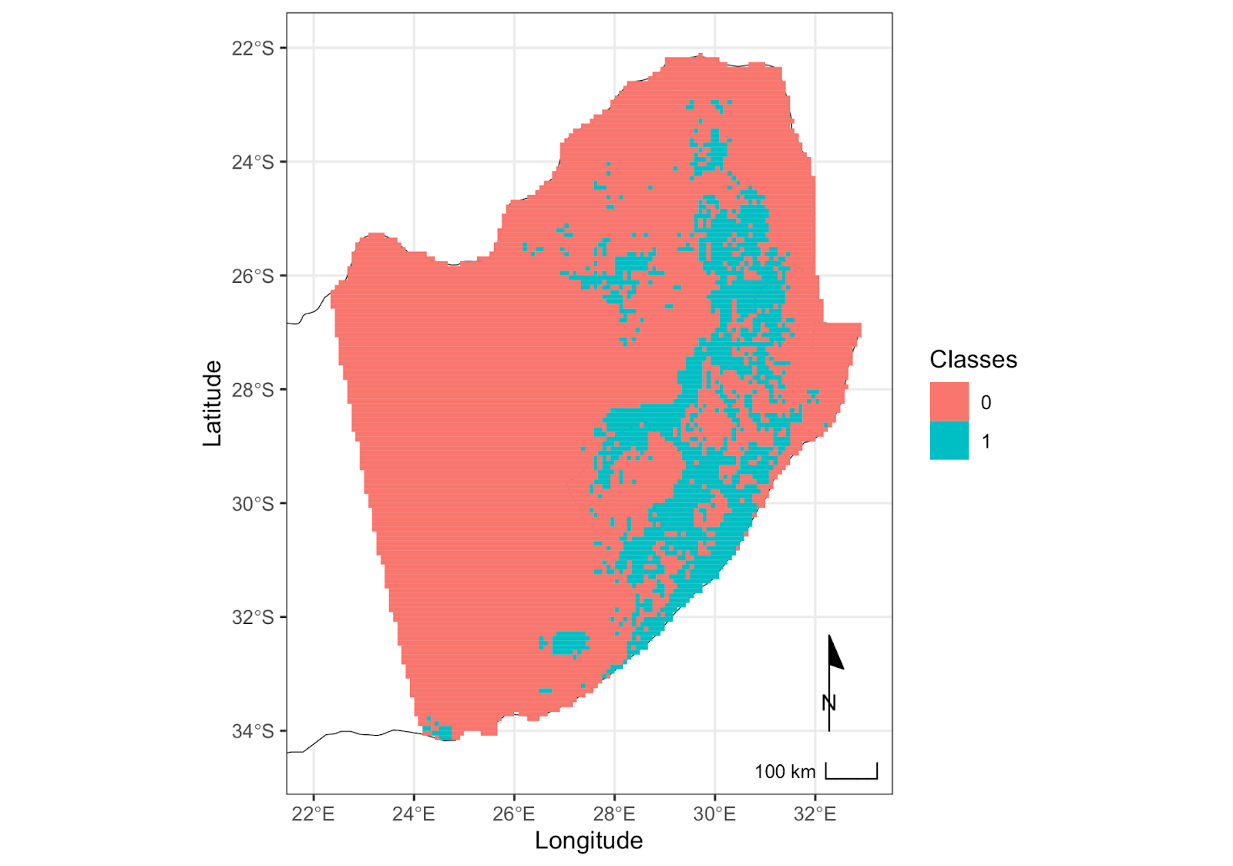
Model evaluation: classification on testing data
Model prediction from training data
SPATIAL ANALYSIS

Slide 18
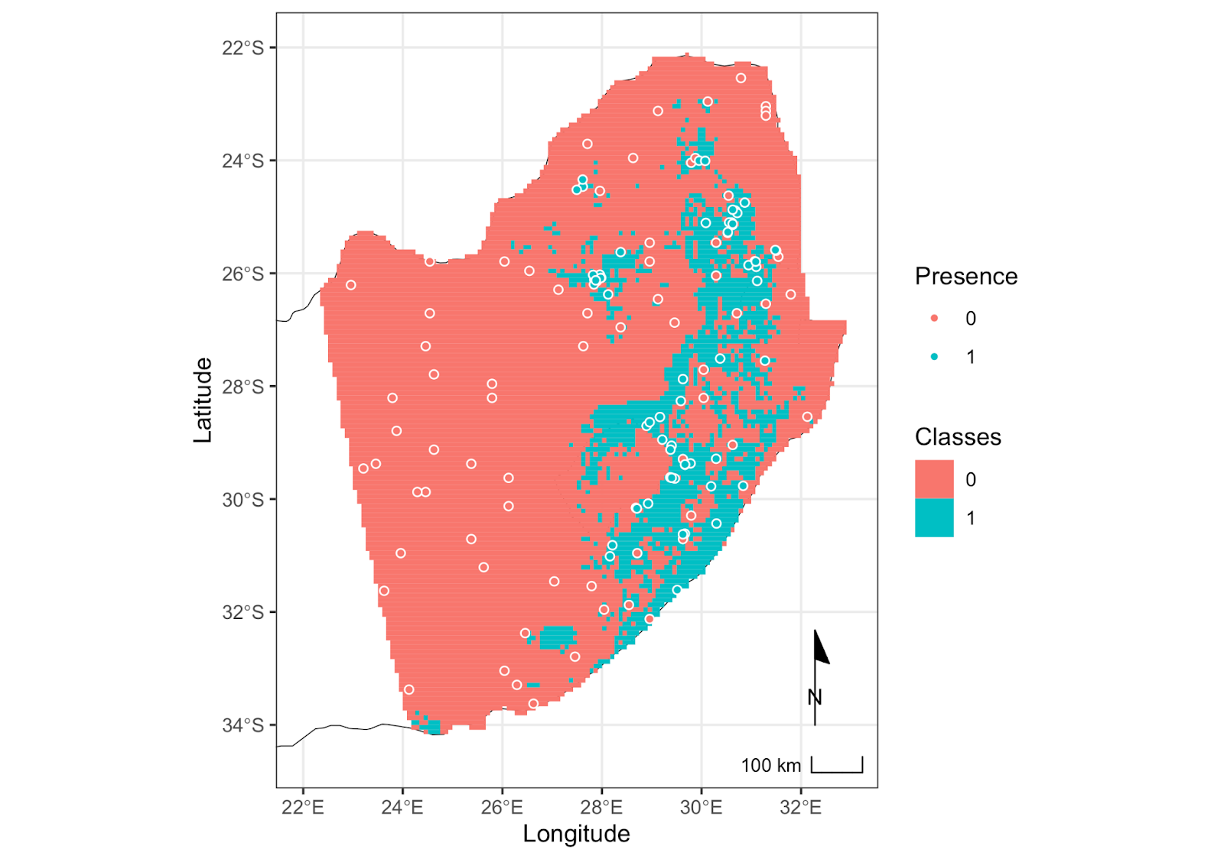
Model evaluation: classification on testing data
Model prediction from training data
See whether actual classes of test data align to these predictions
SPATIAL ANALYSIS

Slide 19
Model evaluation: classification
Confusion matrix
SPATIAL ANALYSIS
 | Predicted: 0 | Predicted: 1
Actual: 0 | True Negative (TN) | False Positive (FP)
Actual: 1 | False Negative (FN) | True Positive (TP)
 | Predicted: 0 | Predicted: 1
Actual: 0 | 55 (TN) | 7 (FP)
Actual: 1 | 13 (FN) | 61 (TP)

Slide 20
Model evaluation: classification
Confusion matrix
SPATIAL ANALYSIS
 | Predicted: 0 | Predicted: 1
Actual: 0 | 55 (TN) | 7 (FP)
Actual: 1 | 13 (FN) | 61 (TP)
Accuracy = | TN (55) + TP (61) | = ~85%
 | TN (55) + TP (61) + FN (13) + FP (7)

Slide 21
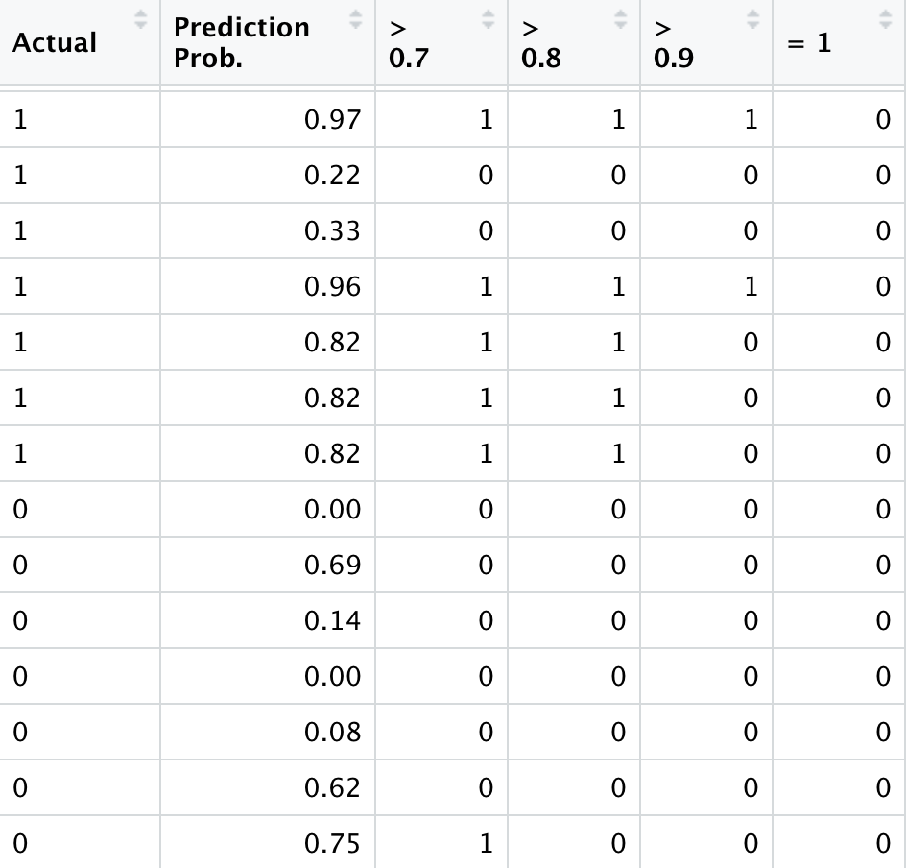
Model evaluation: probability →
Receiver Operator Characteristic & Area Under Curve
SPATIAL ANALYSIS

Slide 22
Model evaluation: probability →
Receiver Operator Characteristic & Area Under Curve
SPATIAL ANALYSIS
Set several thresholds for what
a presence should be. (>0, >0.1, >0.2, etc)
Generate a new confusion matrix each time
 | Predicted: 0 | Predicted: 1
Actual: 0 | 55 (TN) | 7 (FP)
Actual: 1 | 13 (FN) | 61 (TP)

Slide 23
Model evaluation: probability →
Receiver Operator Characteristic & Area Under Curve
SPATIAL ANALYSIS
Set several thresholds for what
a presence should be. (>0, >0.1, >0.2, etc)
Generate a new confusion matrix each time
 | Predicted: 0 | Predicted: 1
Actual: 0 | 68 (TN) | 32 (FP)
Actual: 1 | 0 (FN) | 36 (TP)

Slide 24
Model evaluation: probability → ROC-AUC
True Positive Rate
False Positive Rate
SPATIAL ANALYSIS
Sensitivity = | True Positives
 | True Positives + False Negatives
For each threshold → calculate the TPR & FPR
This shows a tradeoff in model accuracy. We can’t have both a great TPR & FPR at the same time
1- Specificity = | False Positives
 | False Positives + True Negatives

Slide 25
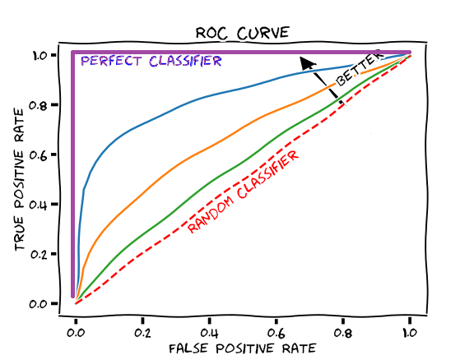
Model evaluation: probability → ROC-AUC
ROC = Receiver Operating Characteristic curve
AUC = Area Under Curve
0.5-0.7 = poor model performance
0.7-0.9 = moderate
>0.9 = excellent
SPATIAL ANALYSIS

Slide 26
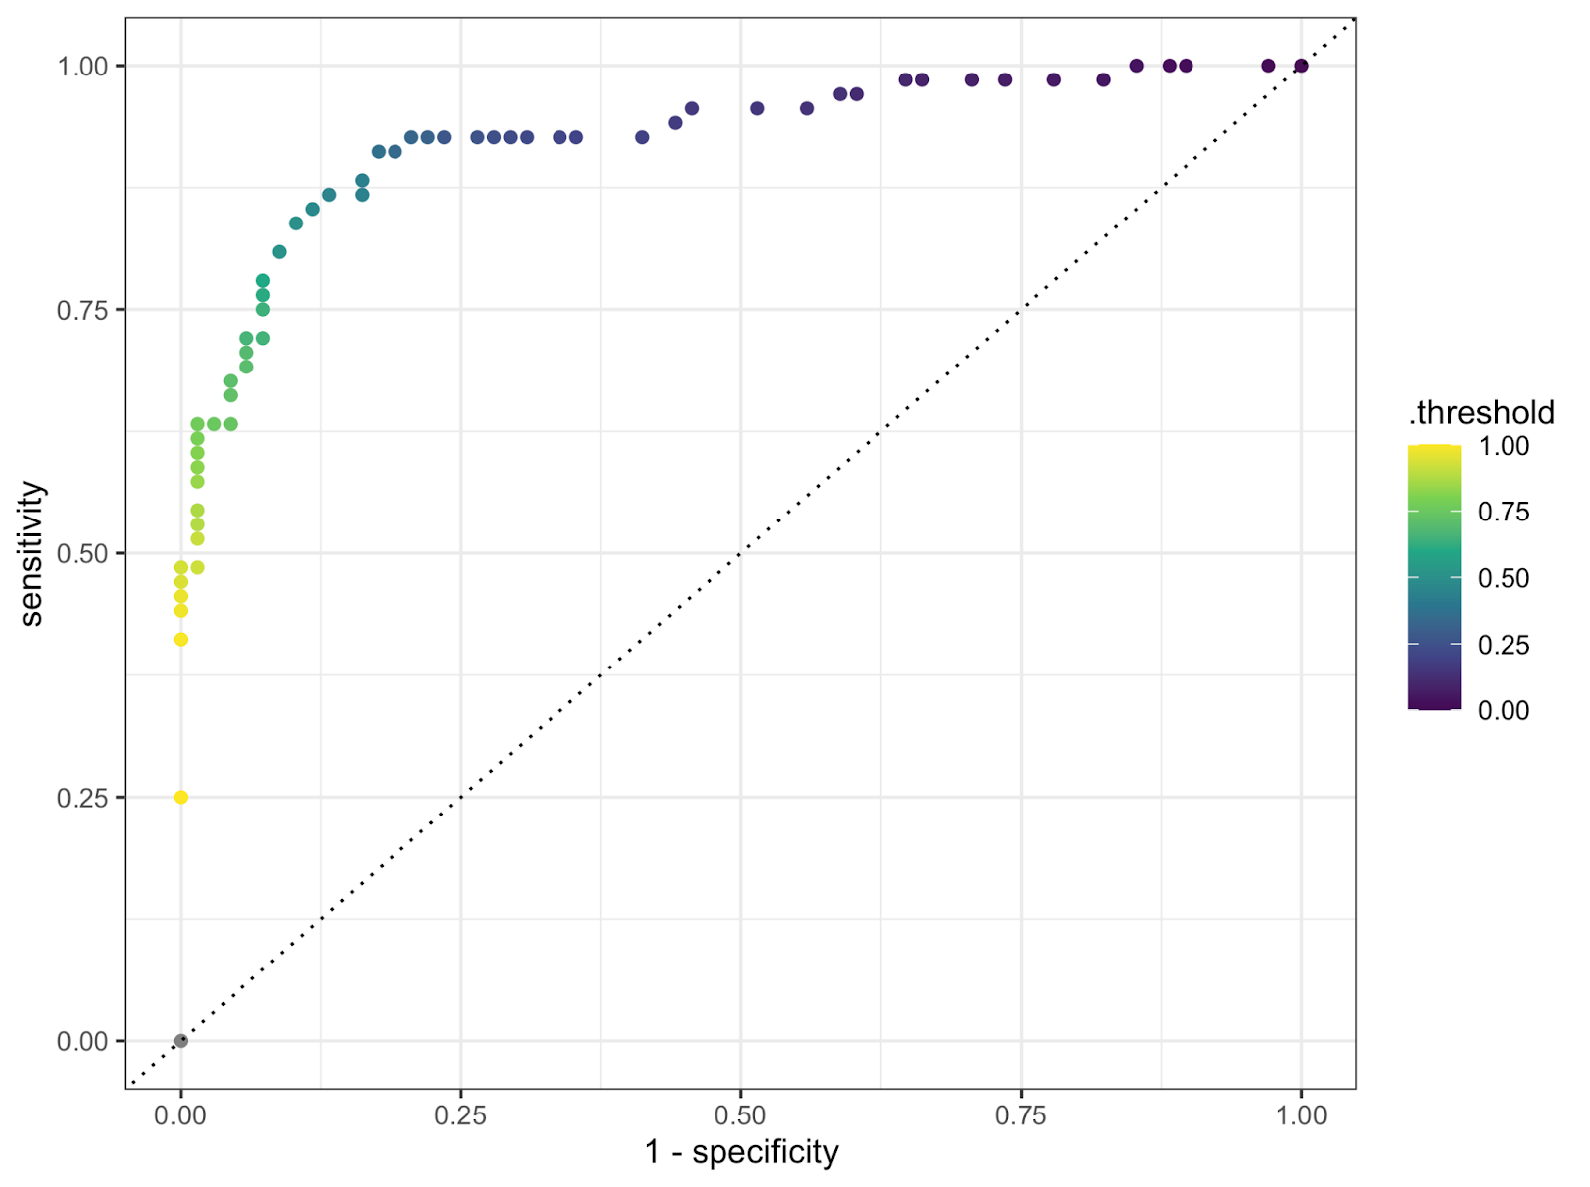
Model evaluation: probability → ROC-AUC
True Positive Rate
False Positive Rate
SPATIAL ANALYSIS

Slide 27
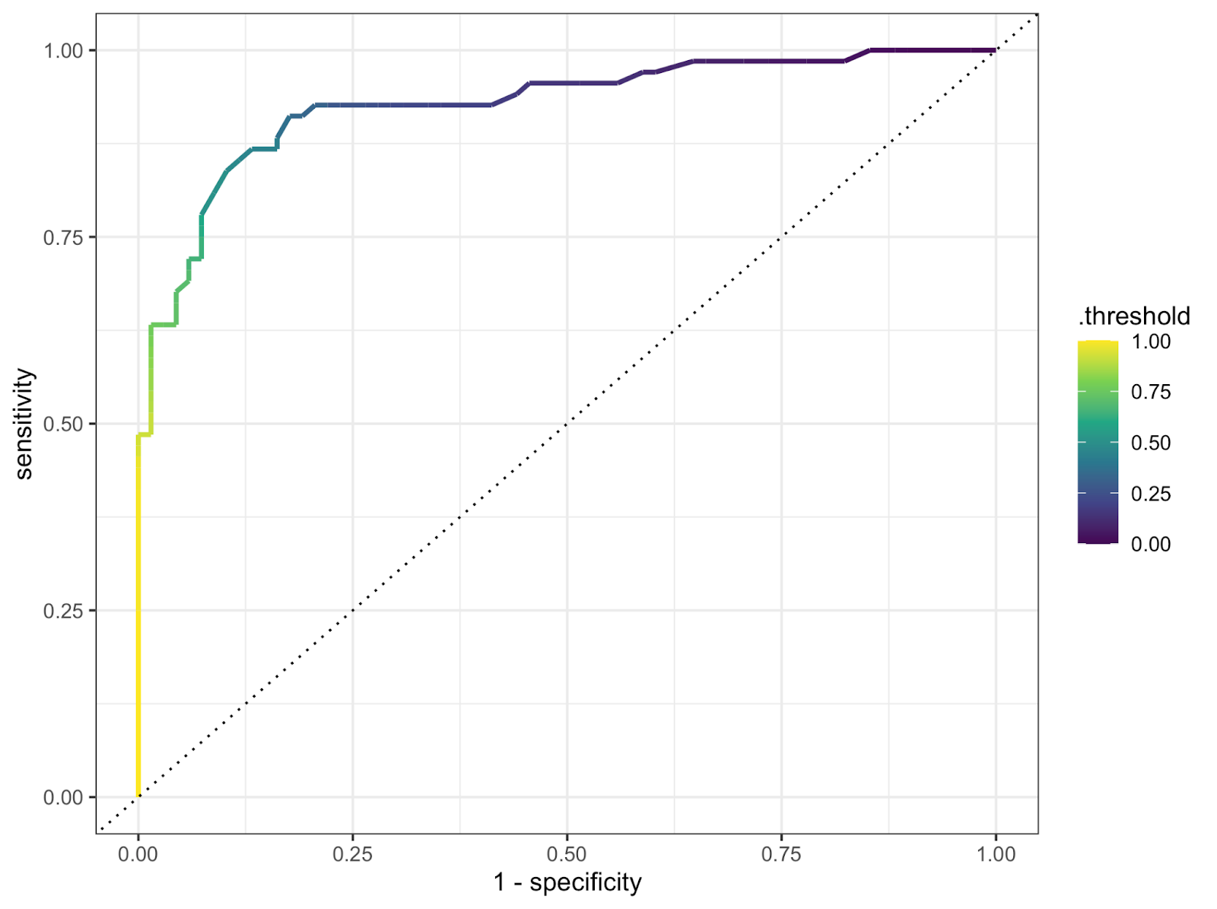
Model evaluation: probability → ROC-AUC
True Positive Rate
False Positive Rate
SPATIAL ANALYSIS

Slide 28
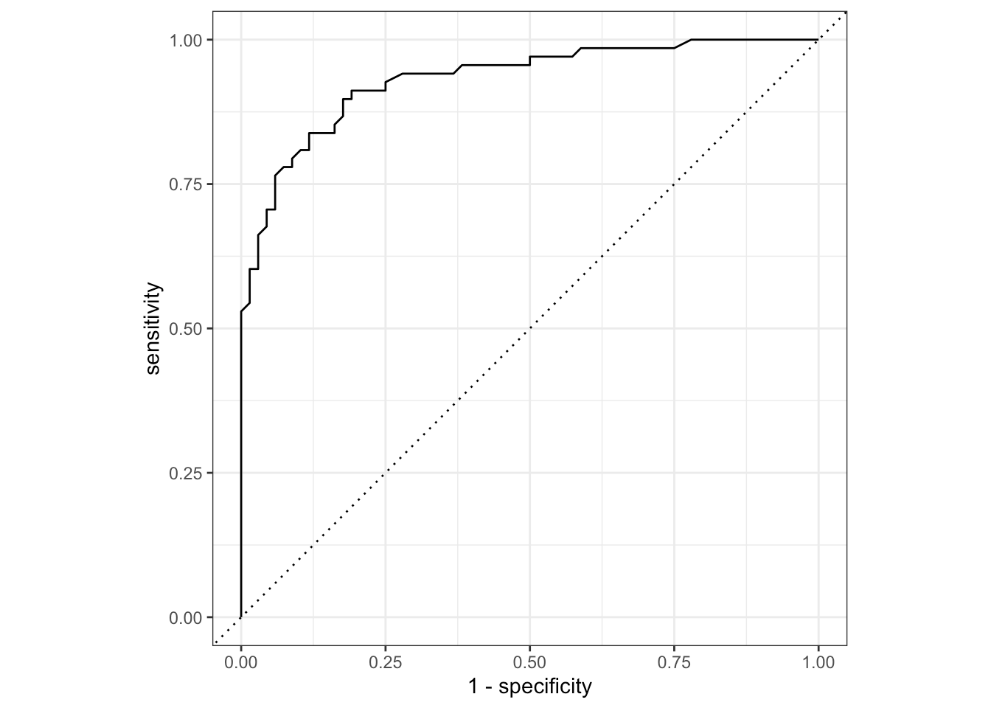
Model evaluation: probability → ROC-AUC
ROC
ROC = Receiver Operating Characteristic curve
AUC = Area Under Curve
SPATIAL ANALYSIS

Slide 29
Model evaluation: variable importance
Using each group’s “impurity” = measure of the importance of each variable
SPATIAL ANALYSIS
Prec > 900 mm
true
false

Slide 30
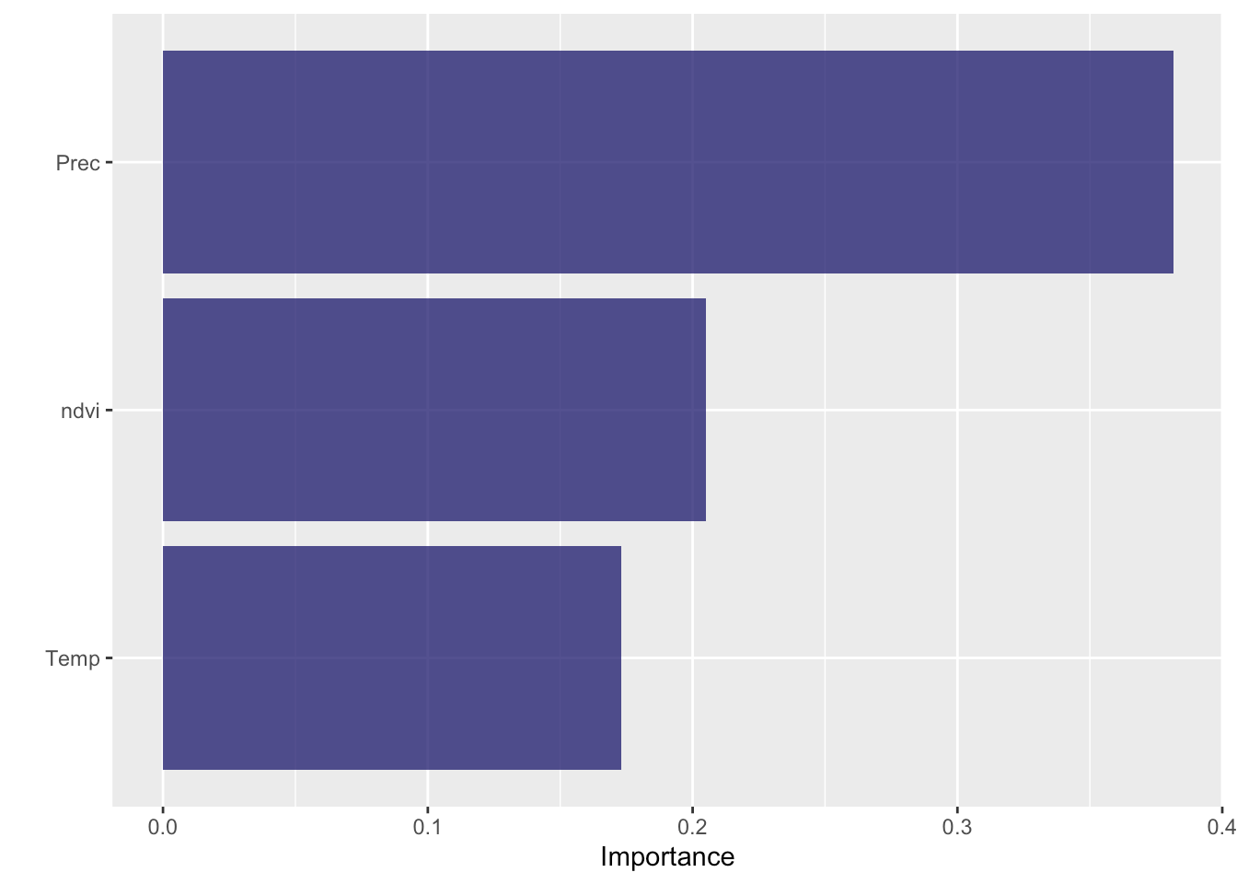
Model evaluation: variable importance
Using each group’s “impurity” = measure of the importance of each variable
SPATIAL ANALYSIS

Slide 31
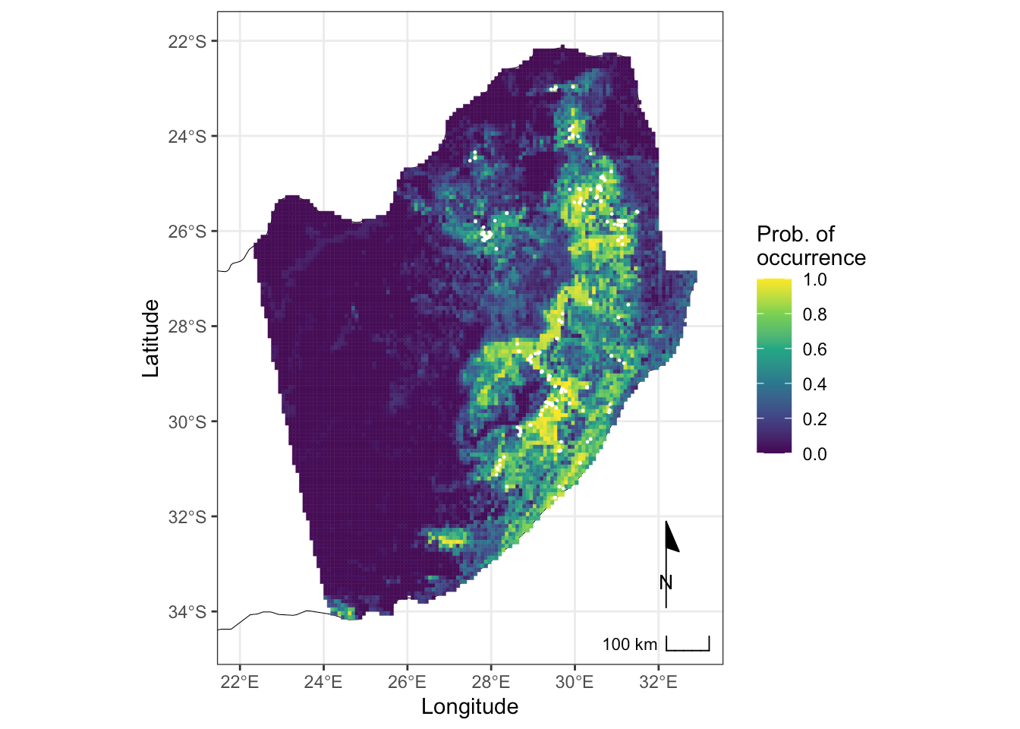
Output: probabilities
SPATIAL ANALYSIS
Probability of occurrence?
This is not really a prediction of where the species occurs
Rather, shows the distribution of suitable habitat based only on the variables we considered

